Slide 1
Ministry/Organization name: Bureau of Police Research and Development Problem Statement: Detection of Child Predators/Cyber Harassers on Social Media Team Name: Kryptonite Team Leader Name: V. Pratishtha Sharma College Code: U-0642
Idea/Approach Details

Slide 2
Idea/Approach details
This idea is born out of a pressing need to curb a growing problem. Even the best of things come with their pitfalls. Growing technology and connectivity has led to an increased number of child predators and cyber stalkers online. Our solution aims to efficiently nip this problem in the bud using advanced Machine Learning techniques such as Support Vector Machines (SVM), Decision Trees, K-Nearest Neighbours and Random Forests.
Idea
Python
Scikit-Learn
NLTK
Pandas
MATLAB
Keras
Technology stack

Slide 3
Idea/Approach details
The use cases for this problem are virtually unlimited. Users on almost all social media websites and discussion forums can fall prey to such predators. Our tool will be prototyped on a particular platform and then generalized to suit the requirements of all such platforms, thereby leaving a huge population much safer than they were before. Any website can use this tool to flag suspicious profiles and become a much better space for all its users.
Use Cases
Through our project, we highlight key concerns of cyber harassment stemming from the use of digital media and discusses existing models of face-to-face bullying which may aid in modelling cyberbullying. This chapter then introduces state-of-the-art research in automated tools to detect cyber harassment. As of now, not much work has been done in this field and also suffers from a severe lack of precision and efficiency. We aim to iron out these flaws and present a novel approach to this age-old problem
Show Stopper

Slide 4
What IS THE PROBLEM?

Slide 5
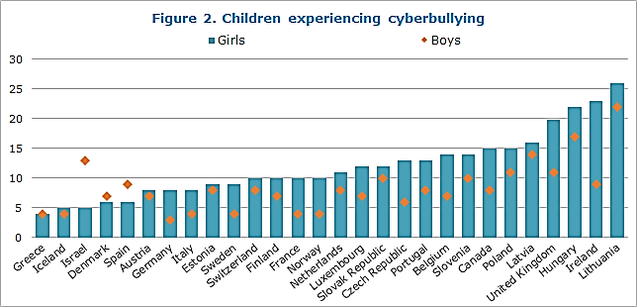


Source: HEALTH BEHAVIOUR IN SCHOOL-AGED CHILDREN. (n.d.). Retrieved February 16, 2020, from http://www.hbsc.org/news/index.aspx?ni=3473) and the 2013 United States School Crime Supplement of the National Crime Victimization Survey (www.icpsr.umich.edu/icpsrweb/NACJD/studies/34980

Slide 6
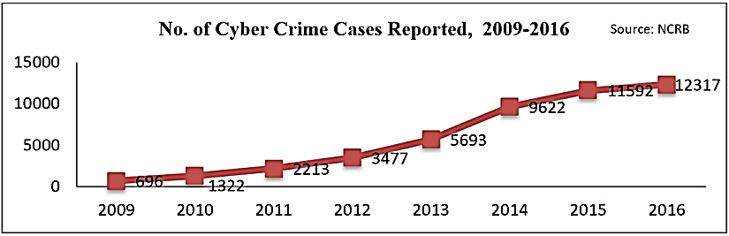
Source: India's digital war: Surge in cyber crime rate highlights need for deeper scrutiny of medium's social, psychological threats. (2017, December 20). Retrieved February 16, 2020, from https://www.firstpost.com/india/indias-digital-war-surge-in-cyber-crime-rate-highlights-need-for-deeper-scrutiny-of-mediums-social-psychological-threats-4267385.html

Slide 7
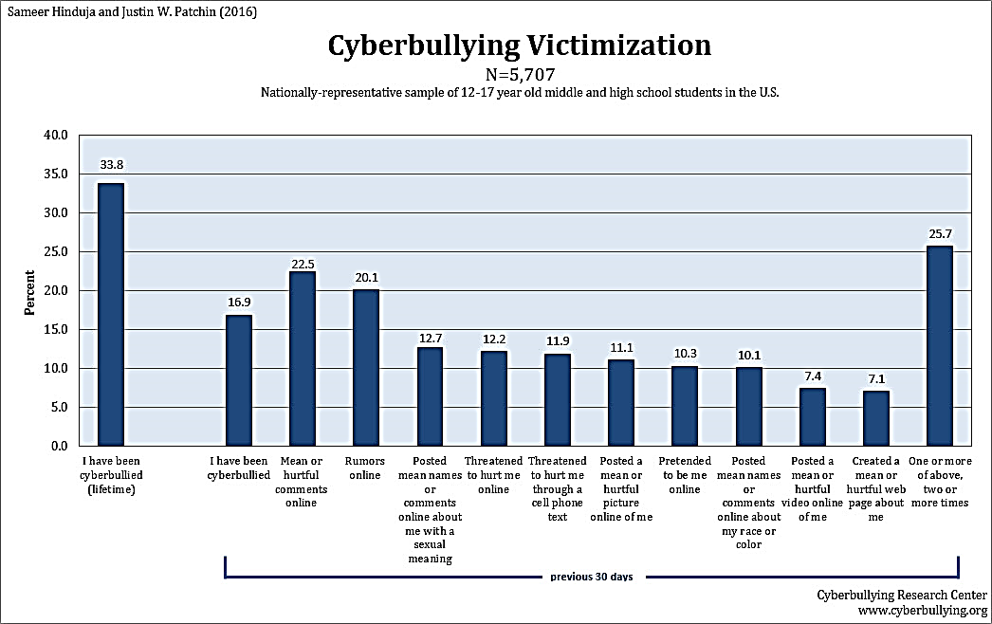
Source: Patchin, J. W., Paula, Paula, Georgina, Georgina, Hinduja, S., & Hinduja, S. (2015, October 21). Our latest research on cyberbullying among school students. Retrieved February 16, 2020, from https://cyberbullying.org/2015-data

Slide 8
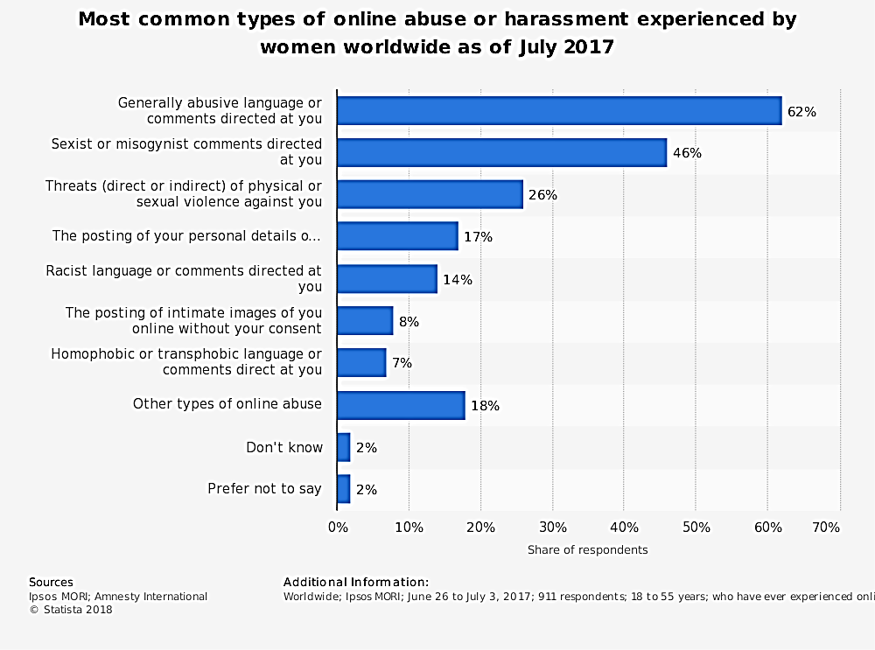
Source: Toxic Twitter - Women's Experiences of Violence and Abuse on Twitter. (n.d.). Retrieved February 16, 2020, from https://www.amnesty.org/en/latest/research/2018/03/online-violence-against-women-chapter-3/

Slide 9
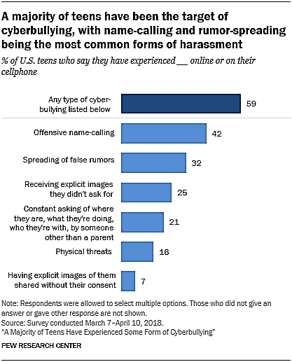
Source: Anderson, M. (2019, December 31). A Majority of Teens Have Experienced Some Form of Cyberbullying. Retrieved February 16, 2020, from https://www.pewresearch.org/internet/2018/09/27/a-majority-of-teens-have-experienced-some-form-of-cyberbullying/

Slide 10
Why tackle this problem?

Slide 11
Majority of children around the globe are bullied online in some form or the other.
Cyberbullying poses significant threat to physical and mental health of the victims.
Unlike other criminals, cyber bullies can hide behind a mask of anonymity online, and do not need direct physical access to their victims to do unimaginable harm.
This tool is a step towards making the cyber-space safer for everyone especially people under the age of 18.

Slide 12
WHAT CAN BE DONE?

Slide 13
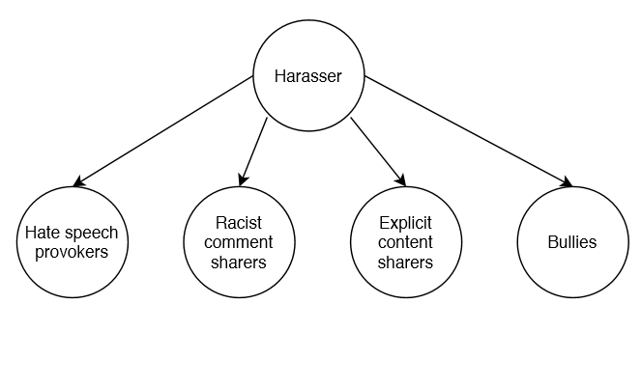
We can work under the assumption that people who are likely to be cyber harassers show either one or more of these behaviors towards minors in the cyber space.
If we can identify the people who send such content out, we can find out who is a threat to others on the internet.

Slide 14
Literature Review of existing algorithms

Slide 15
Escalante, Hugo Jair et al. “Sexual predator detection in chats with chained classifiers.” WASSA@NAACL-HLT (2013).
Describes a novel approach for sexual predator detection in chat conversations based on sequences of classifiers.
The proposed approach divides documents into three parts, which correspond to the different stages that a predator employs when approaching a child.
Local classifiers are trained for each part of the documents and their outputs are combined by a chain strategy.
Proposed a ring-based strategy, in which the chaining process is iterated several times, with the goal of further improving the performance of their method.

Slide 16
Miah, Md. Waliur Rahman et al. “Detection of child exploiting chats from a mixed chat dataset as a text classification task.” ALTA (2011).
The paper investigated the effectiveness of text classifiers to identify Child Exploitation (CE) in chatting.
Along with three traditional text categorizing techniques a new approach was made to accomplish the task.
Psychometric and categorical information by LIWC (Linguistic Inquiry and Word Count) was used and improvement of performance in some classifier was found.
Classification-via-Regression, J-48-Decision-Tree and Naïve-Bayes classifiers are used.

Slide 17
Nandhini, B. Sri and J. I. Sheeba. “Online Social Network Bullying Detection Using Intelligence Techniques.” (2015).
The proposed method was an effective method to detect cyberbullying activities on social media.
The detection method can identify the presence of cyberbullying terms and classify cyberbullying activities in social network such as Flaming, Harassment, Racism and Terrorism, using Fuzzy logic and Genetic algorithm.
The effectiveness of the system was increased using Fuzzy rule set to retrieve relevant data for classification from the input.
In the proposed method Genetic algorithm was also used, for optimizing the parameters and to obtain precise output.

Slide 18
Huang, Qianjia et al. “Cyber Bullying Detection Using Social and Textual Analysis.” SAM@MM (2014).
Aim was to find out if analyzing the social network features can improve the accuracy of cyber bullying detection.
By analyzing the social network structure between users and deriving features such as number of friends, network embeddedness, and relationship centrality, we find that the detection of cyber bullying can be significantly improved by integrating the textual features with social network features.

Slide 19
EXISTING TOOLS AND the NEED TO IMPROVE

Slide 20
CYBER HARASSMENT CAN BE TRACKED Using online available applications and tools. eBlaster, Net Nanny, cloud9 and IamBigBrother are some available commercial tools available to protect children from Internet predators.
They work on the basis of Packet sniffing. These tools scan all the outgoing and ingoing traffic in a network and then apply a filter. But the problem with these tools is that they are based on a simple keyword matching and hence its accuracy is questioned.

Slide 21
PROPOSED SOLUTION

Slide 22
We propose to make a tool that can be deployed by anyone who wishes to monitor the users of their website in order to identify cyber criminals.
The tool will focus on classifying all the users as suspects or non-suspects based on their activities. THIS classification, though has existing algorithms, isn’t done vey efficiently in today’s day and age.
We strive to have a high accuracy, precision and recall in order to create an environment that is safer for the children in the cyber space.
This tool revolutionizes the way automated identification of suspects happens in the world currently.

Slide 23
Dataset and technology stack used
Datasets
Datasets of text conversations on social media
Datasets on information related to search history and visited pages.
Datasets on user activity.
Datasets on user demographics
Technology Stack
Python
Scikit-Learn
NLTK
Pandas
MATLAB
Keras

Slide 24
High-level solution

Slide 25
The proposed tool focuses on higher precision and recall rather than simply taking a gander at the accuracy itself. This is done on the grounds that we would prefer not to leave any "bad" guy escape without being apprehended and on the same hand we don't wish to flag any "good" guy incorrectly.
Keeping this in mind, we aim to use a one of a kind multi-phase classification algorithm and thereafter ensuring that no profile is flagged erroneously in light of their interactions with any other client in a "warm" manner.

Slide 26
APPROACH

Slide 27

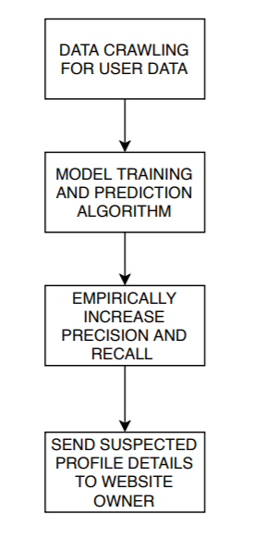


Slide 28
Describe algorithm here.
.
.
.
.
.
.
.
.
.
.
.
.

Slide 29
Proposed 3-phase suspect classification Algorithm

Slide 30

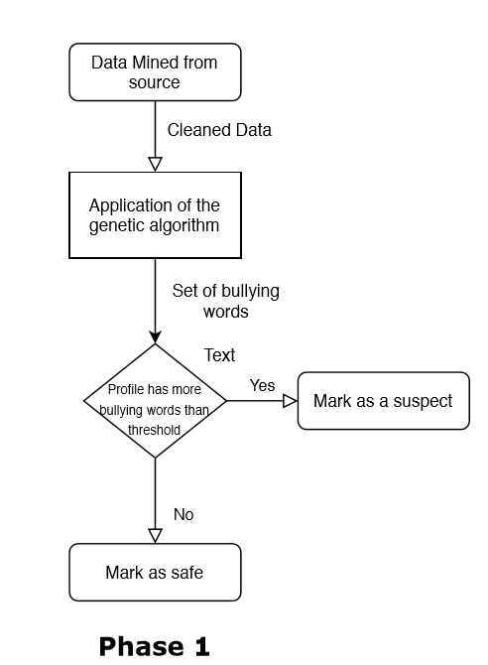
Input given in the form of text conversations is pre-processed first and cleaned.
Cleaned data forwarded for feature extraction
Extracted features are fed to the learning algorithm- Genetic algorithm
Algorithm works on the knowledge base of Fuzzy rules set
Chromosomes compete to predict the classification of bullying activities
Output fed to classifier to classify based on fitness value of the chromosome
Output of the algorithm is a set of classified bullying words

Slide 31
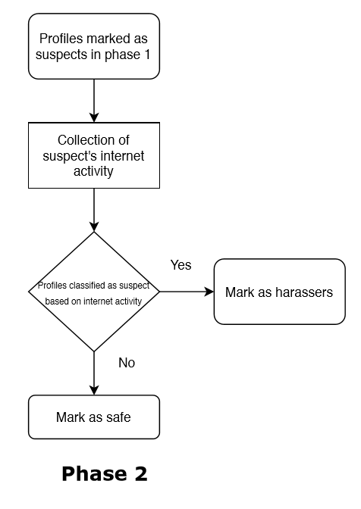
Our unique tool employs not one but 4 different machine learning models to get better results.
The four models have been chosen after extensive literature review.
The suspects’ internet usage is monitored. Special attention is paid to his/her posts, comments, messages and search histories.
Based on these parameters, they are further classified as suspects or non-suspects.
Once the profiles are marked as probable “suspects”, they are then cross verified using machine learning techniques.

Slide 32
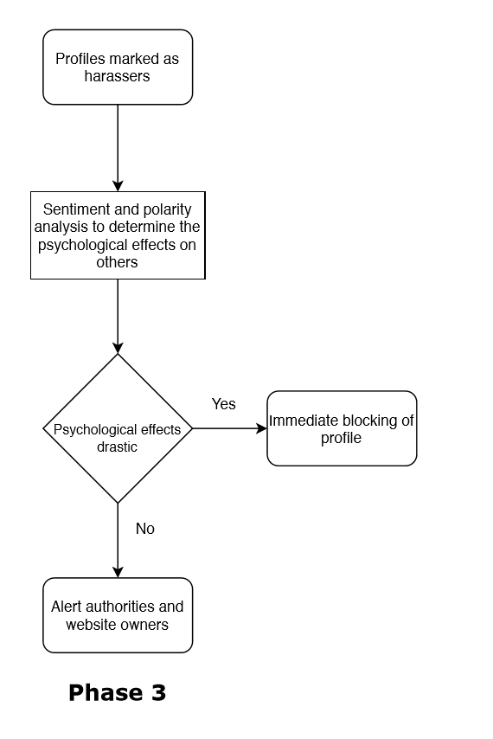
Sentiment analysis is contextual mining of text which identifies and extracts subjective information in source material, and helping a business to understand the social sentiment of their brand, product or service while monitoring online conversations.
It refers to the use of natural language processing, text analysis, computational linguistics, and biometrics to systematically identify, extract, quantify, and study affective states and subjective information.

Slide 33
Machine learning Models employed

Slide 34
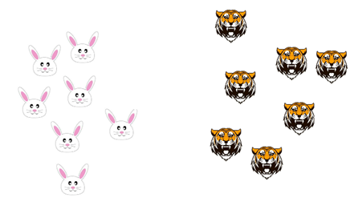
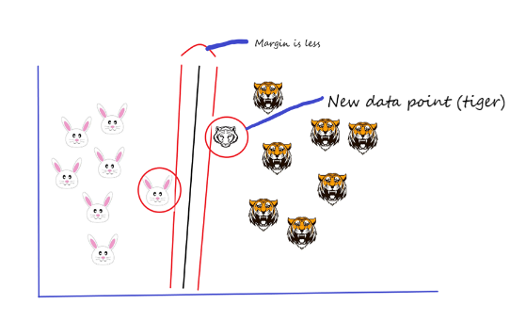
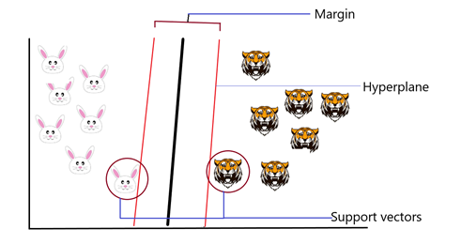

SUPPORT VECTOR MACHINES
A discriminative classifier formally defined by a separating hyperplane.
In two dimension space, this hyperplane is a line dividing a plane into two parts dividing the datapoints into two classes.
Similarly, can be expanded for higher dimensions.
Example-pictorial representation of separating rabbits and tigers by making fence between them.

Slide 35
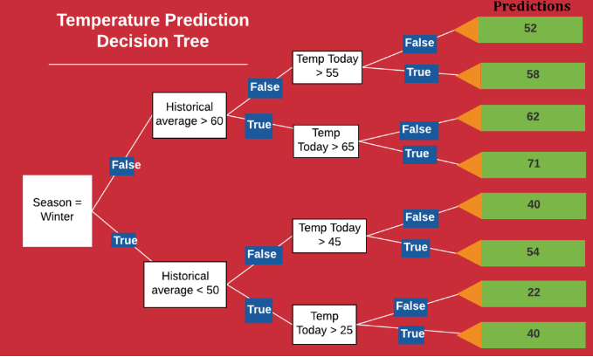
DECISION TREES
A decision supporting tool that uses a tree-like graph or model of decision and their possible consequences.
A flow chart-like structure in which each internal node represents a “test” on an attribute
Each branch represents the outcome of the test, each leaf node represents class label.
Path from root to leaf represents classification rules
Example- temperature prediction model

Slide 36
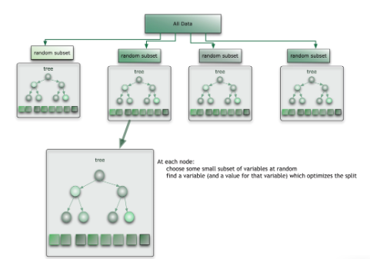
RANDOM FOREST
Random forest is a divide-and-conquer approach used to improve performance.
Can be thought of as a form of nearest neighbor predictor.
The result may either be an average or the weighted average of all of the terminal nodes that are reached.
Runtime is quite fast
Able to deal with unbalanced and missing data

Slide 37
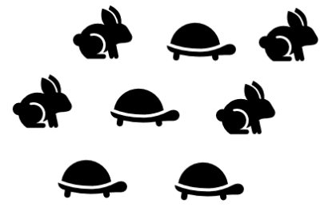
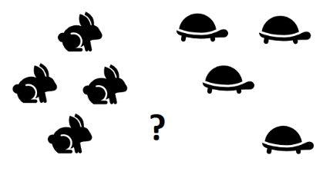
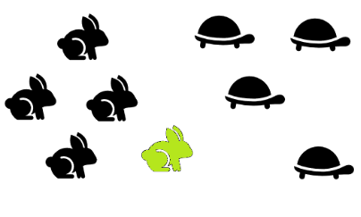
K-NEAREST NEIGHBORS
A non-parametric classification and regression technique.
Input dataset, add any unknown value, and algorithm will tell which class that unknown datapoint belongs to.
The unknown point is classified by simple neighbour voting and class of close neighbours win.
Consider a distribution of random element
Divide them into classes
Place the new element at the nearest distance

Slide 38
METRICS USED

Slide 39



Slide 40
F1 measure vs F2 measure
We aim to measure the accuracy of our tool using F-score
F-score does this using precision and recall values
Since we want to assign equal weightage to both precision and recall we will be utilising the F1 Measure
We would prefer not to leave any "bad" guy escape without being apprehended and on the same hand we don't wish to flag any "good" guy incorrectly.
As with an increase in the value of β, the weightage given to recall increases, we feel that the F1 measure would be most appropriate

Slide 41
Code snippets

Slide 42
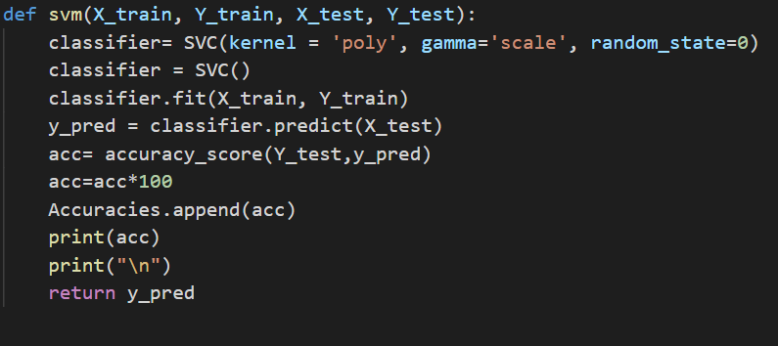

Slide 43
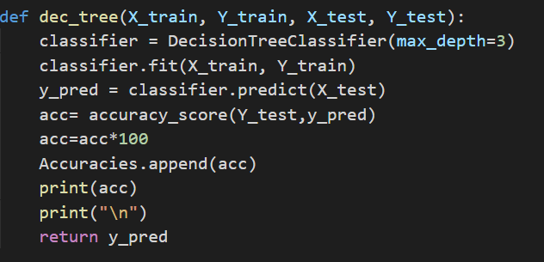

Slide 44
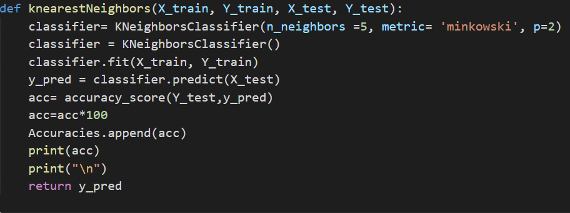

Slide 45
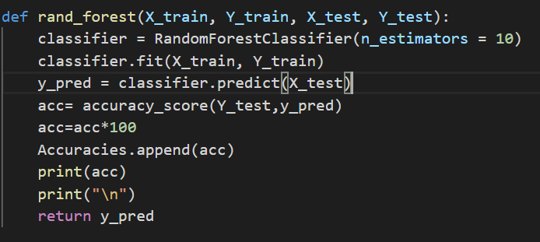

Slide 46
Market Analysis
There are no such tools that are available at a commercial level
Tools like Net Nanny, IamBigBrother and eBlaster mentioned in earlier slides allow monitoring of systems remotely as well as imposing certain restrictions and aim to provide protection through either blocking access to certain types of sites completely or by detection of certain keywords in messages exchanged
Our tool aims to provide a higher level of protection by going through comments and monitoring user activity to detect for the slightest hint of suspicious behaviour

Slide 47
THANK YOU

